Slide 1
Hot Jupiter
2022311224 이진진

Slide 2
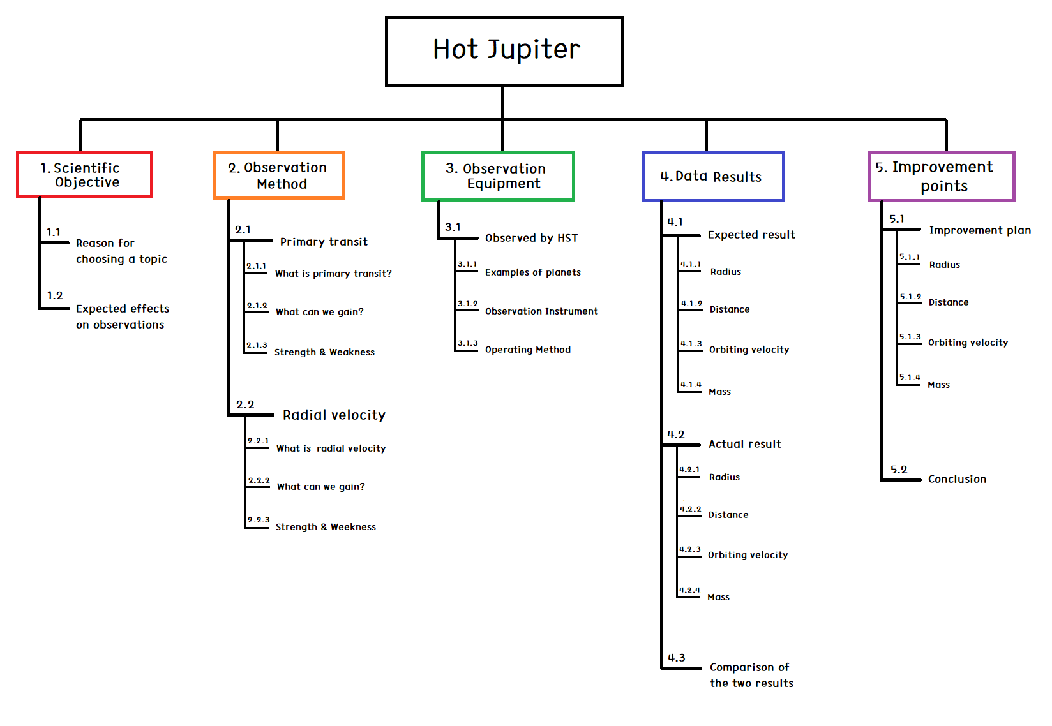
PLAN
Week 7 : Total WBS introduction / Scientific Objective 1.1, 1.2
Week 8 : Modifying overall WBS and PLAN / Observation Method 2.1, 2.2, 2.3
Week 9 : Observation Method 2.1, 2.2
Week 10 : Observation Equipment 3.1
Week 11 :
Week 12 : Data Result 4.1
Week 13 :
Week 14 : Data Result 4.2, 4.3
Week 15 : Improvement points 5.1, 5.2
Week 16 : Conference

Slide 3
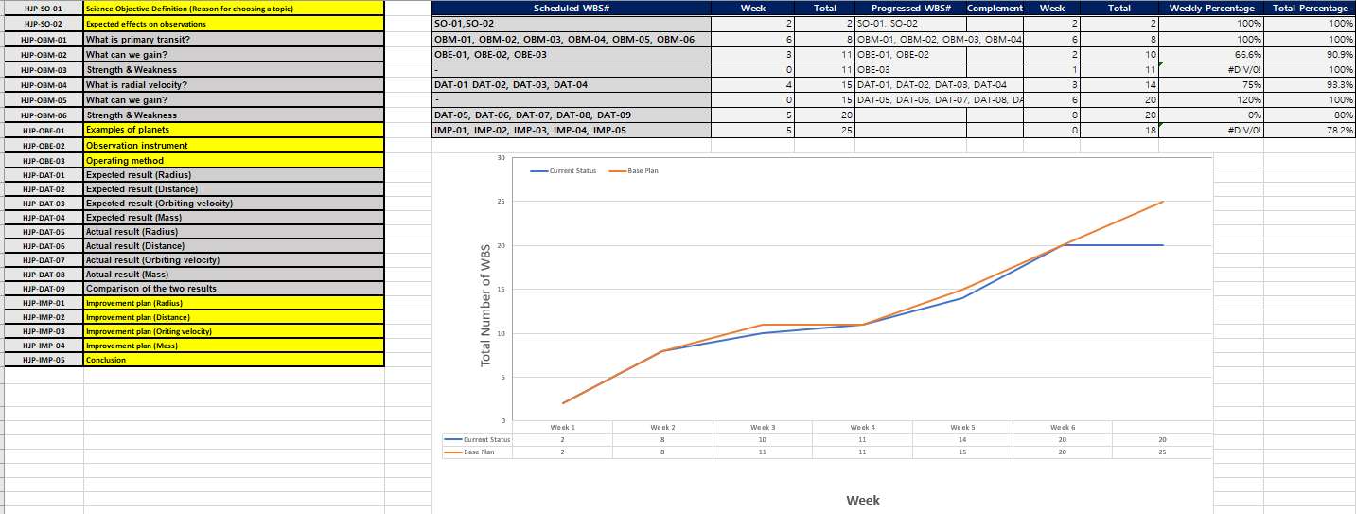
WBS

Slide 4
5.1
Improvement plan – 51 Pegasi b
Radius
Distance
Orbiting velocity
4. Mass

Slide 5
THANK YOU
FOR LISTENING

